Slide 1
Control System Design for a Hypersonic Reentry Vehicle
Joshua Stokes
November 3rd, 2022

Slide 2
Topics
Introduction
Modeling
Control System Design
Analysis Results
Conclusions

Slide 3
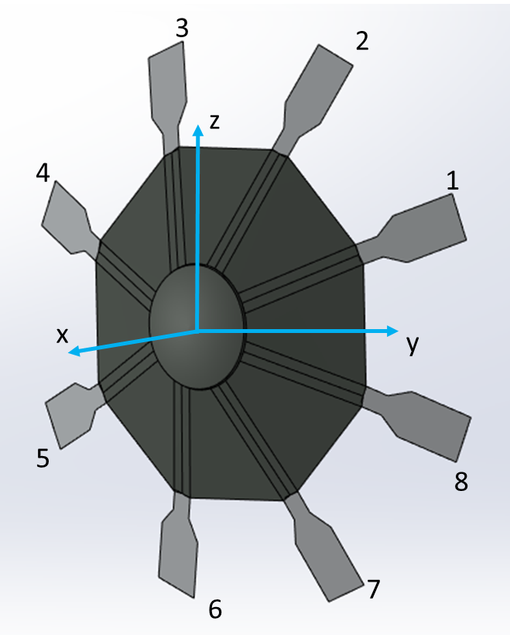
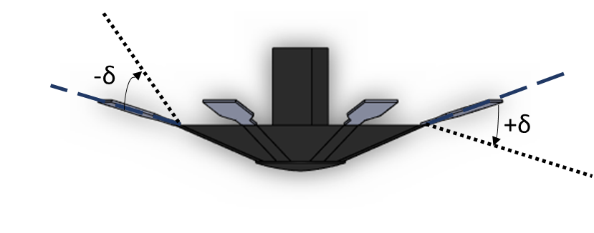
Introduction
The ADEPT class vehicle is a Deployable Entry Vehicle (DEV) consisting of a deployable umbrella-like structure
One of the design challenges that the ADEPT vehicle is faced with is the development of a suitable control system
This is primarily a challenge due to the lack of a backshell on the vehicle
One of the control options being assessed by the NASA Ames Pterodactyl project is the utilization of articulated flaps to control the vehicle
The aim of this project is to further the study of the ADEPT flap control system and develop a feasible controller

Slide 4
Objectives
Develop a control system to control the descent of the ADEPT vehicle
The aim of the control system is to control the vehicle flight path angle and heading angle throughout flight as well as stabilize the vehicle
Utilize Non-Linear Dynamic Inversion (NDI) and Incremental Non-Linear Dynamic Inversion (INDI) in the control system design
Utilizing these inversion methods provide many benefits to control system performance
Verify the control system functionality via simulation analysis

Slide 5
Methodology
A 3D solid model of an ADEPT vehicle was created using gathered reference dimensions
The aerodynamic forces and moments acting on the vehicle were determined by performing a CFD analysis on the created 3D solid model
The vehicle equations of motion were incorporated into a six degree of freedom (6DOF) simulation to model the system dynamics
The 6DOF simulation utilizes the aerodynamic data from the CFD analysis
The 6DOF simulation was utilized to analyze control system performance

Slide 6
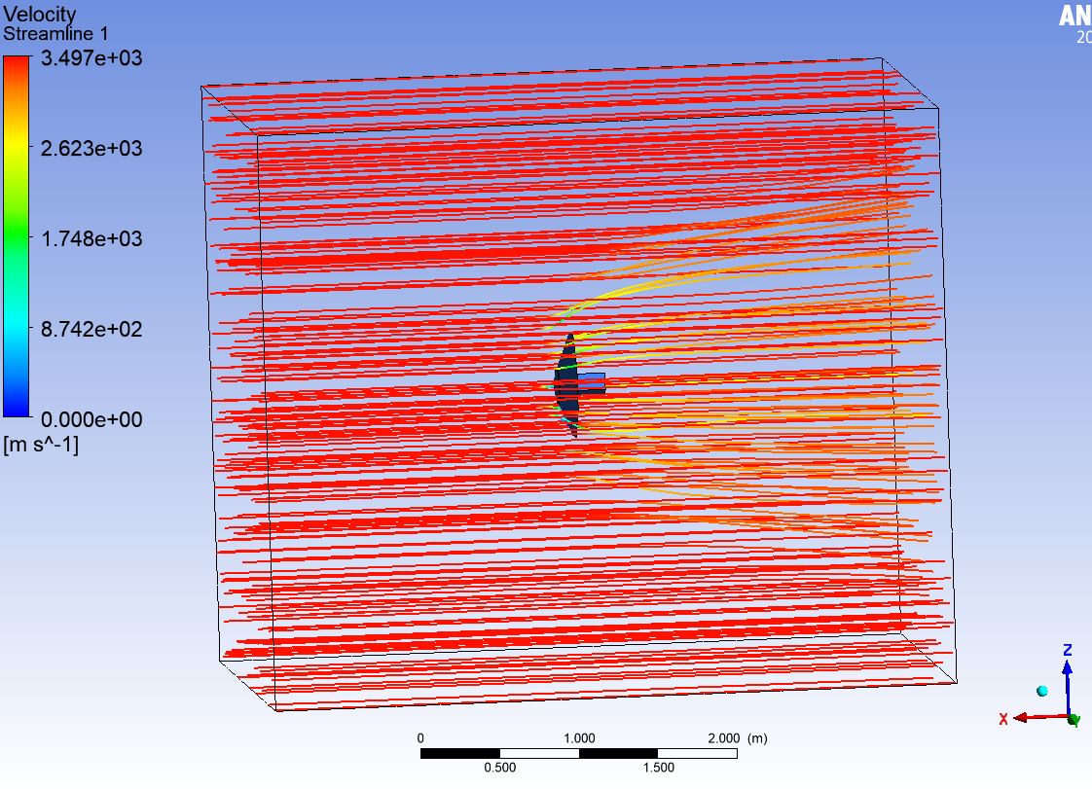
Aerodynamics
A CFD analysis was performed using ANSYS Fluent to compute the aerodynamic force and moment coefficients of the vehicle and the control flaps for a set of configurations
The conditions varied between configurations were as follows: angle of attack, sideslip angle, and flap deflection angles
All angles were varied from -20 to 20 degrees
The force and moment coefficients computed were saved into a database to be utilized by the simulation

Slide 7
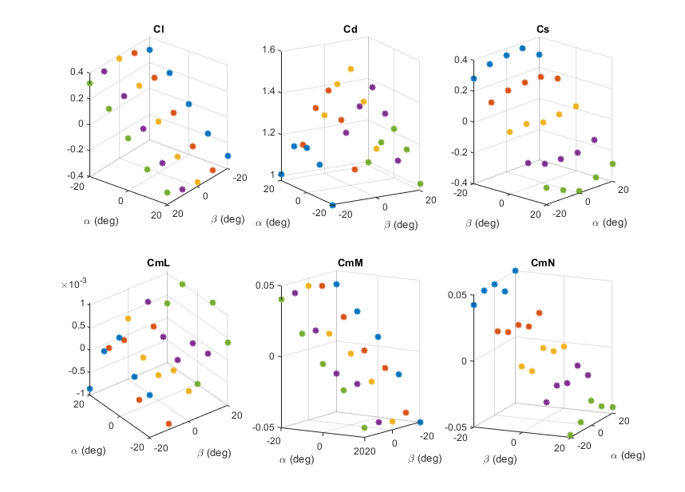
Aerodynamics - Results
A set of example results from the CFD analysis are shown below:
ADEPT Vehicle Main Structure CFD Results
Flap Deflection CFD Results (0 AoA 0 SS)

Slide 8
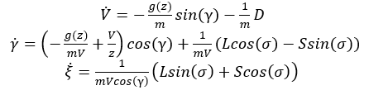
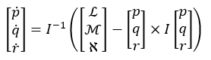
Equations of Motion
The following equations of motion of the reentry vehicle are utilized in the simulation to model the system dynamics
Linear Dynamics
Rotational Dynamics

Slide 9
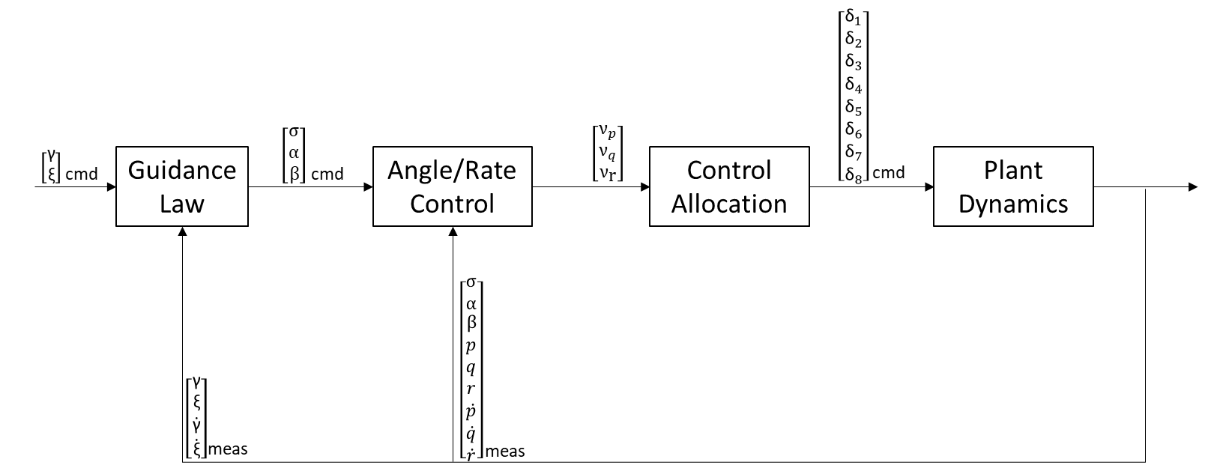
Control System Architecture
The control system consists of three major submodules, all operating at a 500 Hz sample rate
The guidance law takes the commanded heading angle and flight path angle and computes vehicle angle of attack, sideslip, and bank angle commands
The Angle/Rate control module computes moment commands in the vehicle body frame
The control allocation module computes the flap deflection angles required to achieve the commanded angular accelerations

Slide 10
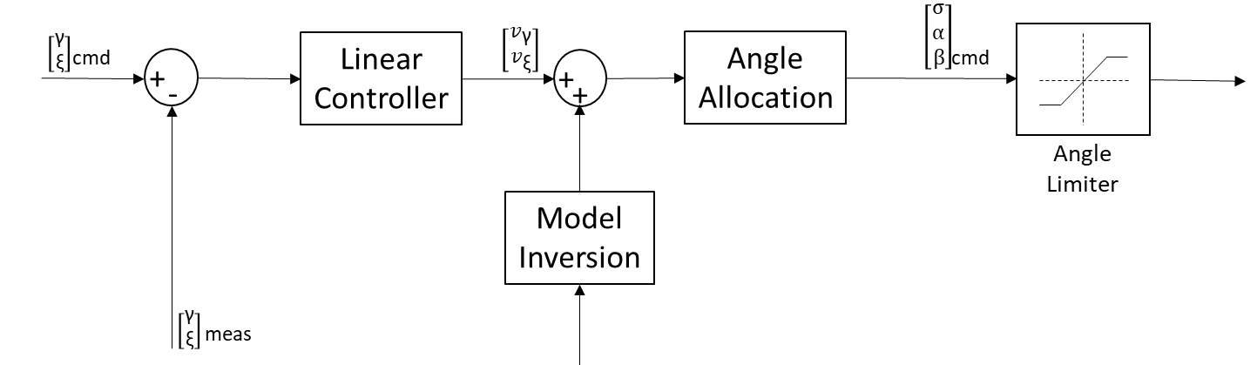
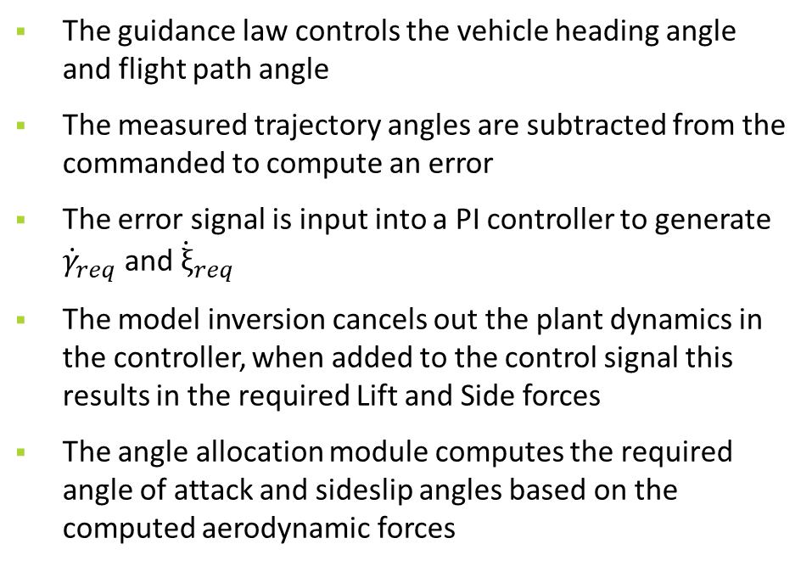
Guidance Law
The guidance law controls the vehicle heading angle and flight path angle
The measured trajectory angles are subtracted from the commanded to compute an error
The error signal is input into a PI controller to generate ${\dot{γ}}_{req}$ and ${\dot{ξ}}_{req}$
The model inversion cancels out the plant dynamics in the controller, when added to the control signal this results in the required Lift and Side forces
The angle allocation module computes the required angle of attack and sideslip angles based on the computed aerodynamic forces
Symbol | Description | Value
kp | Proportional Gain | 1.92
ki | Integral Gain | 0.4

Slide 11
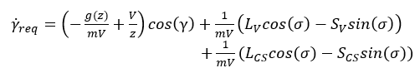

Guidance Law – Model Inversion (NDI)
The guidance law model inversion module inverts the system flight path angle and heading angle dynamics to generate aerodynamic force commands
To begin, the flight path angle equation of motion is rewritten to split the aerodynamic Lift and Side forces into the contributions from the vehicle and the control surfaces
The equation can then be rearranged to solve for the Lift and Side force required by the vehicle in order to obtain the desired flight path angle dynamics

Slide 12

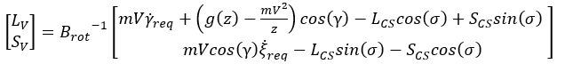
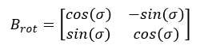
Guidance Law – Model Inversion (NDI continued)
The previous steps are repeated for the vehicle heading angle, resulting in the following equation
The two equations are combined into a matrix equation and the Lift and Side forces can be solved for, resulting in:
The resulting formula, along with state feedback, is utilized by the control system to compute the vehicle Lift and Side force commands
where:

Slide 13
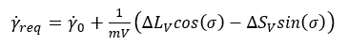

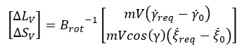

Guidance Law – Model Inversion (INDI)
For the INDI version of the guidance law the flight path angle and heading angle equations of motion are linearized using a first order Taylor series approximation
The equations are simplified using the time-scale separation assumption, resulting in the following:
The equations are then rearranged to solve for the required incremental Lift and Side force commands
Where ${\dot{γ}}_{0}$ and ${\dot{ξ}}_{0}$ are the measurements from the previous timestep

Slide 14
Guidance Law – Angle Allocation
The Lift and Side forces computed by the dynamic inversion process are used to calculate the angle of attack and sideslip angle commands
A linear fit of the CFD data is used to determine the vehicle lift as a function of angle of attack, and side force as a function of sideslip angle
The required angle of attack and sideslip are then computed using the slope and intercept of this linear fit
The bank angle command is set to zero throughout flight as it is not needed to control the vehicle trajectory

Slide 15
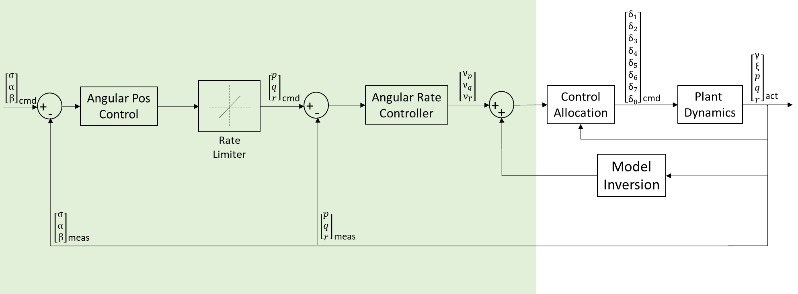
Angle and Rate Controller
The Angle and Rate Controller consists of two feedback control loops in series
The angle controller controls the vehicle angle of attack, sideslip, and bank angles using a proportional feedback controller
Generates rotation rate commands for the angles
Converts the angular rate commands into body frame rates via a coordinate transformation
The rate controller consists of a proportional feedback controller that generates acceleration commands
The acceleration commands are combined with model inversion outputs to obtain moment commands
Symbol | Description | Value
k_{pa} | Proportional Gain (Angle) | 6.0
k_{pr} | Proportional Gain (Rate) | 18.0

Slide 16
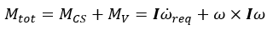
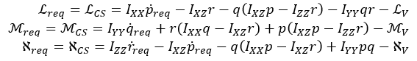
Angle and Rate Controller – Model Inversion (NDI)
The rate control inversion module inverts the system rotational dynamics to generate aerodynamic moment commands
To begin, the total moment in the rotational equations of motion are split into the control surface and vehicle contributions
The previous equation is then expanded and rearranged to solve for the aerodynamic moments required to be provided by the control surfaces

Slide 17
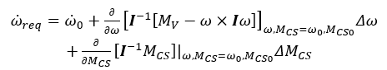
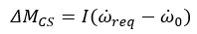
Angle and Rate Controller – Model Inversion (INDI)
For the INDI version of the rate controller the rotational equations of motion are linearized using a first order Taylor series approximation
The equations are simplified using the time-scale separation assumption and then the incremental moment command is solved for, resulting in the following

Slide 18
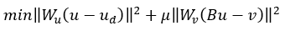
Control Allocation
After computing the required moments, the control law determines the corresponding allocation of the control inputs (flap deflection angles)
The control allocation is computed by solving a quadratic cost function and determine the optimal control inputs
The following equation represents the cost function that is optimized:
After formulating the cost function, it is solved using an active set method algorithm

Slide 19
Analysis – Rate Controller
The figures to the right display the step response for the closed loop rate controller using the two inversion schemes
The results show that both methods respond to the pitch and yaw rate steps while maintaining a small roll rate
The axis decoupling benefits provided by Dynamic Inversion are also apparent in the results

Slide 20
Analysis – Angle Controller
The figures to the right display the step response for the closed loop angle controller using the two inversion schemes
In both cases the control system responds as expected to the commands
A small amount of coupling can be seen in the bank angle
To be expected since the dynamic inversion process is only applied to the vehicle body axis rotations
These rotations do not translate directly to the bank, angle of attack, and sideslip angles

Slide 21
Analysis – Guidance Law Scenario One (Constant Input)
The guidance law is first tested using a constant command input for heading angle and flight path angle
The simulation initializes with a flight path angle of -5.5º and a heading angle of 0º and vehicle is commanded to hold those initial conditions constant throughout the test
The angle of attack and side slip angle are initialized at zero and must rotate to the correct positions which induces some initial error in the response
This is done to assess the robustness of the controller

Slide 22
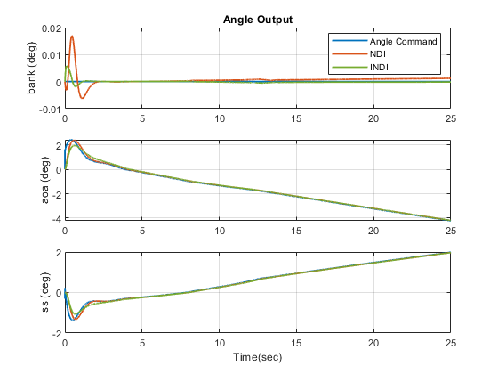
Analysis – Guidance Law Scenario One (Constant Input)
Both control schemes successfully hold the commanded velocity vector direction constant as expected
The NDI response shows a larger steady state error, although this error is still extremely small
The error can be attributed to mismatches between the interpolated aerodynamic model data used in the control law and the true model data
The angle/rate controller successfully tracks the commands generated by the guidance law

Slide 23
Analysis – Guidance Law Scenario Two (Ramp Input)
The second test scenario initializes with a flight path angle of -5.5 degrees and heading angle of 0 degrees
Beginning at time zero, a ramp input is commanded to the flight path angle for 10 seconds
A ramp rate of 0.02 degrees per second is used
Following the initial ramp, the flight path angle is held constant and a ramp input is commanded to the heading angle

Slide 24
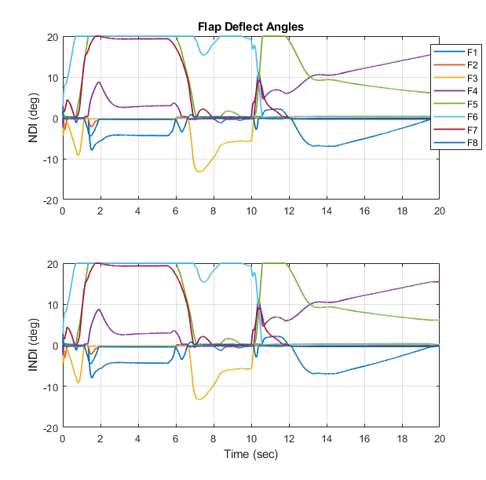
Analysis – Guidance Law Scenario Two(Ramp Input)
Both control schemes successfully track the ramp command inputs
It can be observed that control signal saturation degrades tracking performance
Angle of attack command is saturated during flight path angle ramp
Flap deflections are saturated during both profiles

Slide 25
Flight Condition Variation
To further assess the robustness of the controller, the control system was tested under various initial flight conditions
Due to the implementation of dynamic inversion, changes in flight conditions should have minimal impact on system performance
A total of nine cases were executed with the same angle of attack and sideslip angle command profile
Case Number | Initial Mach Number | Initial Altitude (km)
1 | 20 | 80
2 | 20 | 100
3 | 20 | 120
4 | 30 | 80
5 | 30 | 100
6 | 30 | 120
7 | 40 | 80
8 | 40 | 100
9 | 40 | 120

Slide 26
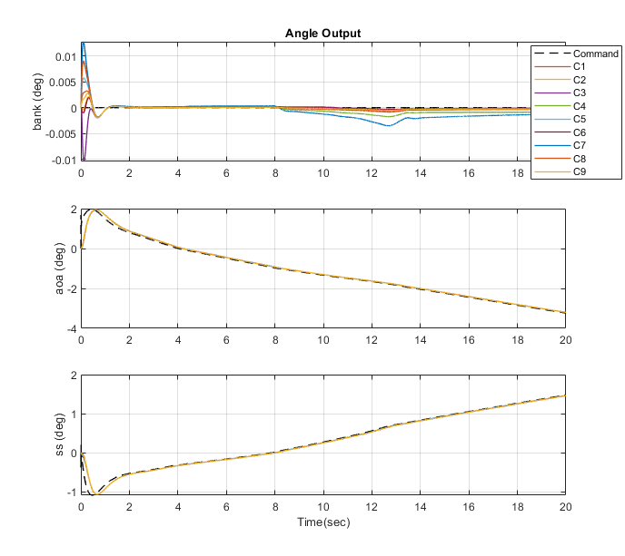
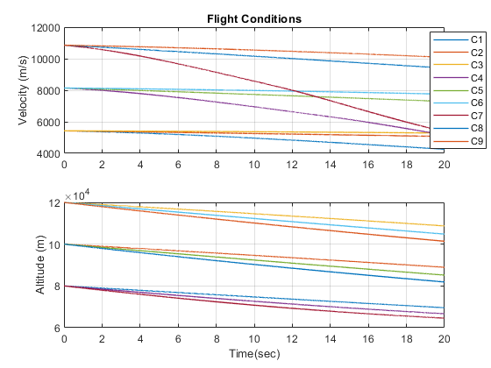
Flight Condition Variation (Results)
The flight condition variation results for the INDI controller are shown below
The results show that the flight conditions have minimal impact on the controller performance as expected

Slide 27
Parameter Uncertainty
The simulation results presented in the previous sections utilized near-perfect modeling knowledge in the controller
The NDI and INDI processes both utilize some level of modeling knowledge to compute forces and torques
To assess the effect of modeling uncertainty, a 10% error factor was applied to the aerodynamic force and moment coefficients
These conditions were used along with the guidance law constant input test to observe the effects of the model mismatch

Slide 28
Parameter Uncertainty (Results)
The error factor has a noticeable effect on the NDI system performance
This is due to the NDI method’s increased reliance on model parameters
The results show that the effects of the error factor on the INDI control law are negligible
These results are expected since the INDI replaces the plant dynamics model with state feedback in the controller
NDI Results
INDI Results

Slide 29
Conclusions
The dynamic inversion-based control system has been proven to be capable of stabilizing and controlling the vehicle trajectory throughout a range of flight conditions
Simulation results show that the control system successfully tracks the commands and remains stable
The two inversion schemes analyzed show similar performance when model uncertainties are small
NDI performance is shown to suffer more as the uncertainty magnitude increases

Slide 30
Backup

Slide 31
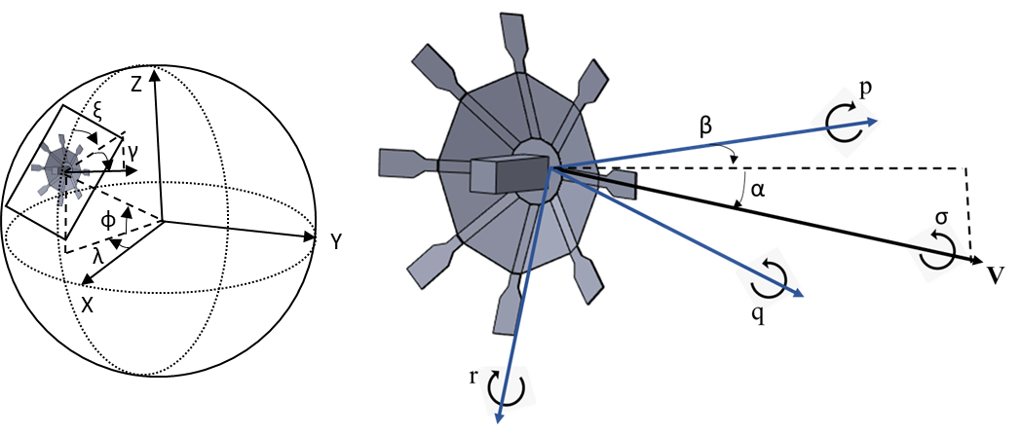
Vehicle Model
The images to the right depict the ADEPT vehicle model utilized throughout the analysis
The eight control flaps deflect into and out of the airflow to control the aerodynamic moments acting on the vehicle
The images below depict the coordinate frames used for the analysis

Slide 32
Dynamic Inversion

Slide 33
Dynamic Inversion
The control system utilizes dynamic inversion to generate control inputs
Dynamic inversion utilizes the knowledge of the plant dynamics in the control law to effectively cancel out their effects
With the nonlinear plant dynamics being cancelled out by the dynamic inversion, the control system design is simplified
Assuming perfect inversion, the resulting system becomes a linearized and uncoupled system that can be controlled by traditional means
In reality modeling errors are present and will affect overall closed-loop performance
Two dynamic inversion methods were tested and compared: NDI and INDI
The controller has the capability of switching between the two methods via a configurable parameter

Slide 34
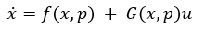
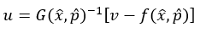
Dynamic Inversion
The following steps outline the NDI formulation for an arbitrary system:
Where f(x,p) represents the system dynamics absent of any control inputs and G(x,p) represents the contribution due to the control inputs
To begin the NDI formulation, the state derivative is replaced by the virtual command (v)
The equation is then rearranged to solve for the control input
Thus, by utilizing the knowledge of the plant and the control effectiveness matrix, the control input can be computed
This method relies on accurate model knowledge to be effective

Slide 35

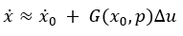
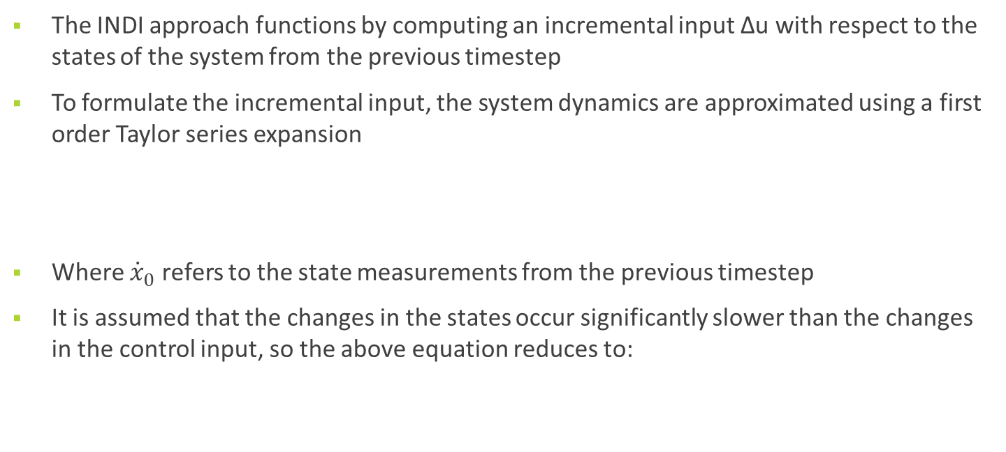
Dynamic Inversion
The INDI approach functions by computing an incremental input Δu with respect to the states of the system from the previous timestep
To formulate the incremental input, the system dynamics are approximated using a first order Taylor series expansion
Where ${\dot{x}}_{0}$ refers to the state measurements from the previous timestep
It is assumed that the changes in the states occur significantly slower than the changes in the control input, so the above equation reduces to:

Slide 36
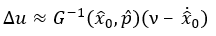

Dynamic Inversion
The previous equation can then be rearranged to solve for the incremental control input
The total control input can be updated by adding the incremental input to a running sum
The advantage of utilizing this formulation is that the only modeling information required is the control effectiveness (G)
The additional modeling information required by NDI is replaced by the state feedback measurements

Slide 37
Analysis – Dynamic Inversion (Rate Control)
Prior to testing the closed-loop rate control module, both rate control dynamic inversion modules are tested open loop
To accomplish this, angular acceleration commands coming from the rate controller are replaced with constant acceleration inputs
A constant acceleration of 1 m/sec^2 is commanded in both pitch and yaw while the roll acceleration is held at zero
This is done to verify that the performance of dynamic inversion and the control allocation is as expected
Theoretically if the dynamic inversion functions perfectly, the resulting rate output would be a simple integration of the commanded acceleration

Slide 38
Guidance Law – Model Inversion (INDI Filtering)
The INDI method requires the use of filtering on the commands and state feedback
A discretized first-order Butterworth filter with a cutoff frequency of 250 Hz is implemented for this purpose
The simulation utilized to test the control system did not include sensor noise characteristics
Additional filter design may be necessary after adding sensor noise

Slide 39
Control Allocation (Cost Function Inputs)
Symbol | Name | Description
W_{u} | Physical input weighting matrix | All eight control flaps are weighted evenly, thus this is an 8x8 identity matrix
u | Physical control input | The physical flap deflection angles
u_{d} | Desired control input | The desired deflection angles, set to keep flap angles near zero
μ | Relative weighting constant | Set to 10-6 to prioritize the weighting on the physical control inputs
W_{v} | Virtual input weighting matrix | All three control flaps are weighted evenly, thus this is an 3x3 identity matrix
B | Control effectiveness matrix | Consists of localized slopes of the flap aerodynamic moment coefficients with respect to deflection angle
ν | Virtual Control input | The computed roll, pitch and yaw moment commands

Slide 40
Analysis Overview
The control system analysis is split up into a series of tests designed to exercise the various control loops
The performance control loop is assessed individually, starting from the innermost loop (rate control)
All tests are executed using both NDI and INDI controllers and results are overlayed when applicable
After assessing the performance of the control loops, additional stressing cases are executed to assess controller robustness

Slide 41
Analysis – Dynamic Inversion (Rate Control)
The results for the NDI test are presented to the right
The acceleration plots show that after an initial transient, the accelerations reach the commanded values and remain there for the remainder of the simulation
The flap deflection angles are shown to change with time as the vehicle accelerates

Slide 42
Analysis – Dynamic Inversion (Rate Control)
The results for the INDI test are presented to the right
It is apparent that the initial transient is different than the NDI results
there are oscillations in the response before the acceleration converges to the commanded values
This is because INDI relies on the filtered state feedback signals, so it requires time to converge on the correct solution
The duration of these oscillations is short, and the algorithm successfully functions as expected following the startup transient

Slide 43
Recommendations
All state feedback utilized in the simulation was fed directly from the state variables without any additional sensor noise or error modeling
To improve the fidelity of the model, sensor modeling should be included to assess the effect that these factors have on the control system performance
After improving the modeling fidelity, the controller should be tuned to meet a realistic set of control requirements
Lastly, the control system should be verified by testing realistic flight profiles
The analysis presented in this report was limited in that it did not include a method of generating realistic flight path angle and heading angle profiles over the course of an entire flight

Slide 44
